Slide 1
Spring Microservices &
Spring Cloud

Slide 2
Spring Microservices
Microservices coined by Dr Peter Rodgers in 2005 , was initially known as micro web services.
The main principle behind microservices is to break up single large
‘monolithic’ system into multiple independent components/processes.

Slide 3
Monolith Applications
Monoliths are characterized by
Large Application Size
Long Release Cycles
Large Teams
Typical Challenges include
Scalability Challenges
New Technology Adoption
New Processes - Agile?
Difficult to Automation Test
Difficult to Adapt to Modern Development Practices
Adapting to Device Explosion
Monolith applications are typically huge - more 100,000 line of code. In
some instances even more than million lines of code.

Slide 4
Characteristics of Microservices
A microservice architecture has the following characteristics:
Application logic is broken down into small-grained components with well-defined boundaries of responsibility that coordinate to deliver a solution.
Each component has a small domain of responsibility and is deployed completely independently of one another.
A Microservice is responsible for a single part of a business domain. Also,
a microservice should be reusable across multiple applications.
Microservices communicate based on a few basic principles (not standards) and employ lightweight communication protocols such as HTTP and JSON (JavaScript Object Notation) for exchanging data between the service consumer and service provider
Microservices—by their small, independent, and distributed nature— allow organizations to have small development teams with well-defined areas of responsibility.

Slide 5
Microservices
Microservices architecture allows decoupled components to be built and deployed independently to integrate into a single larger system.
It means that these individual components are loosely coupled with each other, each having a tight cohesion.
These components interact with each other through a standard XML/JSON interface irrespective of the technologies used to create the component.
Some of the well-known large companies who have successfully applied microservices architectures are: Amazon, eBay, Gilt, Netflix, PayPal, and Twitter.

Slide 6
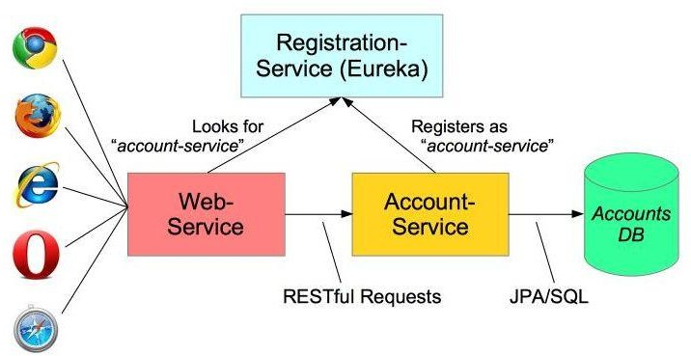
Microservices
Microservices allow large systems to be built up from a number of collaborating
components.
It does at the process level what Spring has always done at the component level: loosely coupled processes instead of loosely coupled components.
For example imagine an online shop with separate microservices for user- accounts, product-catalog, order-processing and shopping carts:
Inevitably there are a number of moving parts that we have to setup and configure to build such a system.

Slide 7
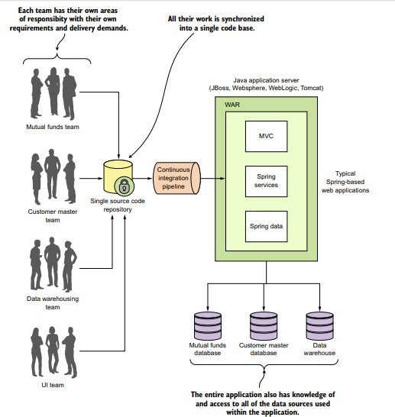
Monolithic Application
Monolithic applications force multiple development teams to artificially synchronize their delivery because their code needs to be built, tested, and deployed as an entire unit.

Slide 8
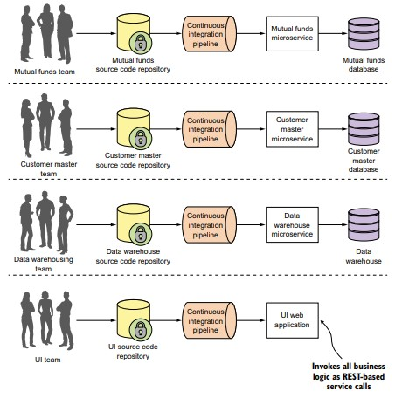
Microservices
Using a microservice architecture our CRM application would be decomposed into a set of microservices completely independent of each other, allowing each development team to move at their own pace.

Slide 9
Microservices
Microservice Architectures evolved as a solution to the scalability and innovation challenges with Monolith architectures.
Developing a single application as a suite of small services each running in its own process and communicating with lightweight mechanisms, often an HTTP resource API.
Important Characteristics
REST - Built around RESTful Resources. Communication can be HTTP
or event based.
Small Well Chosen Deployable Units - Bounded Contexts
Cloud Enabled - Dynamic Scaling

Slide 10
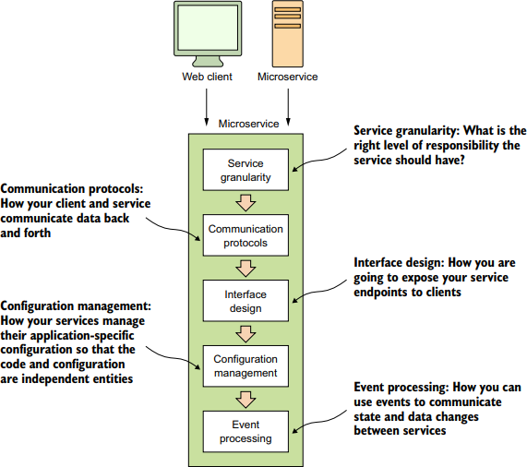
Core microservice development pattern
Following diagram highlights the basic service design.

Slide 11
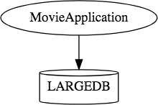
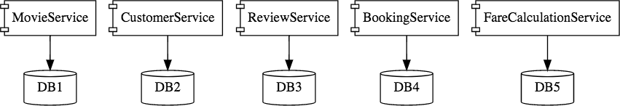
How does Microservice Architecture look like?
Monolith Application. One application for everything.
Same application when developed using Microservices Architecture.
Microservice Architectures involve a number of small, well designed,
components interacting with messages.

Slide 12
Advantages of Microservices
Advantages of using Microservices –
It gives developers the freedom to independently develop and deploy services.
Improves the scalability with the ability to individually scale services as needed.
Better fault tolerance, which means that if one micro service fails, the others will continue to deliver.
Code for different services can be written in different languages.
The micro service architecture enables continuous delivery.
New Technology & Process Adaption becomes easier.
You can try new technologies with the newer microservices
that we create.
Faster Release Cycles
Scaling with Cloud

Slide 13
Spring Cloud
We can develop stand alone microservices applications using Spring Boot, but suppose we now have to connect the various applications and build a distributed system?
Solution is Spring Cloud.
Spring Cloud–an open-source library–makes it easy to develop JVM applications for the cloud.
Spring Cloud is a collection of open source technologies from companies such as Netflix and HashiCorp that have been “wrapped” with Spring annotations to significantly simplify the setup and configuration of these services.
With it, applications can connect to services and discover information about the cloud environment easily in multiple clouds such as Cloud Foundry and Heroku.
Further, you can extend it to other cloud platforms and new services.

Slide 14
Spring Cloud
One of the many advantages of running an application in the cloud is easy availability of a variety of services.
Instead of managing hardware, installation, operation, backups, etc., you simply create and bind services with a click of a button or a shell command.
Spring Cloud builds on Spring Boot by providing a bunch of libraries that enhance the behaviour of an application when added to the classpath.

Slide 15
Using Spring Cloud in building microservices
The Spring team has integrated a wide number of battle tested open source projects into a Spring subproject collectively known as Spring Cloud. (http://projects.spring.io/spring-cloud/).
Spring Cloud wraps the work of open source companies such as Pivotal, HashiCorp, and Netflix in delivering patterns.

Slide 16
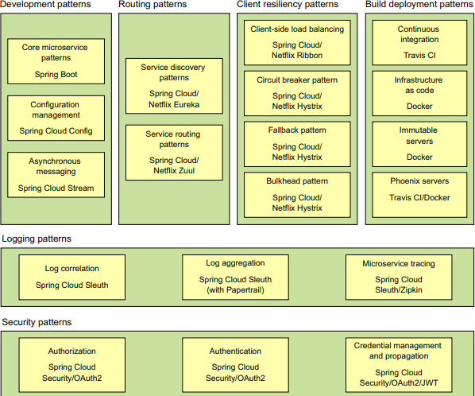
Using Spring Cloud in building microservices

Slide 17
Using Spring Cloud in building microservices
Spring Boot Spring Boot is the core technology used in microservices implementation.
Spring Boot greatly simplifies microservices development by simplifying the core tasks of building REST-based microservices.

Slide 18
Using Spring Cloud in building microservices
When developing distributed microservices with Spring Boot we face the following
issues-
Complexity associated with distributed systems-
This overhead includes network issues, Latency overhead, Bandwidth issues, security issues.
Service Discovery-
Service discovery tools manage how processes and services in a cluster can find and talk to one another. It involves a directory of services, registering services in that directory, and then being able to lookup and connect to services in that directory.
Redundancy-
Redundancy issues in distributed systems.
Load balancing-
Load balancing improves the distribution of workloads across multiple computing resources, such as computers, a computer cluster, network links, central processing units, or disk drives.
Performance issues-
Performance issues due to various operational overheads.
Deployment complexities-
Requirement of Devops skills.

Slide 19
Main Spring Cloud modules to build distributed Microservices
Spring Cloud
Spring Cloud provides solutions to cloud-enable your microservices. It leverages and builds on top of some of the Cloud solutions open sourced by Netflix (Netflix OSS).
Important Spring Cloud Modules
Dynamically scale up and down. using a combination of
Naming Server (Eureka Server)
Ribbon (Client Side Load Balancing)
Feign (Easier REST Client, easier than RESTTemplate)
Visibility and monitoring with
Zipkin Distributed Tracing
Netflix API Gateway
Configuration Management with Spring Cloud Config Server.
Fault Tolerance with Hystrix.

Slide 20
Spring Cloud service discovery
Spring Cloud service discovery With Spring Cloud service discovery, you can abstract away the physical location (IP and/or server name) of where your servers are deployed from the clients consuming the service.
Service consumers invoke business logic for the servers through a logical
name rather than a physical location.
Spring Cloud service discovery also handles the registration and
deregistration of services instances as they’re started up and shut down.
Spring Cloud service discovery can be implemented using Consul (https:// www.consul.io/) and Eureka (https://github.com/Netflix/eureka) as its service discovery engine.

Slide 21
Using Spring Cloud in building microservices
Spring Cloud/Netflix Hystrix and Ribbon
Spring Cloud heavily integrates with Netflix open source projects.
For microservice client resiliency patterns, Spring Cloud wraps the Netflix Hystrix libraries (https://github .com/Netflix/Hystrix) and Ribbon project (https://github.com/Netflix/Ribbon).
Using the Netflix Hystrix libraries, you can quickly implement service client
resiliency patterns such as the circuit breaker and bulkhead patterns.
While the Netflix Ribbon project simplifies integrating with service discovery agents such as Eureka, it also provides client-side load-balancing of service calls from a service consumer.

Slide 22
Using Spring Cloud in building microservices
Spring Cloud/Netflix Zuul
Spring Cloud uses the Netflix Zuul project (https://github.com/Netflix/zuul)
to provide service routing capabilities for your microservice application.
Zuul is a service gateway that proxies service requests and makes sure that all calls to your microservices go through a single “front door” before the targeted service is invoked.
With this centralization of service calls, you can enforce standard service policies such as a security authorization authentication, content filtering, and routing rules.
Note:
Finchley.RELEASE is Spring cloud Gateway.
Spring Cloud Gateway is an API Gateway built on top of Spring Webflux and Reactor Netty. It is a next generation gateway and can be viewed as a replacement for Spring Cloud Netflix Zuul.

Slide 23
Using Spring Cloud in building microservices
Spring Cloud Sleuth Spring Cloud Sleuth (https://cloud.spring.io/spring-cloud- sleuth/) allows you to integrate unique tracking identifiers into the HTTP calls and message channels (RabbitMQ, Apache Kafka) being used within your application.
These tracking numbers, sometimes referred to as correlation or trace ids, allow you to track a transaction as it flows across the different services in your application.
With Spring Cloud Sleuth, these trace IDs are automatically added to any logging statements you make in your microservice.

Slide 24
Using Spring Cloud in building microservices
Spring Cloud Security
Spring Cloud Security (https://cloud.spring.io/spring-cloud-security/) is an authentication and authorization framework that can control who can access your services and what they can do with your services.
Spring Cloud Security is token-based and allows services to communicate with one another through a token issued by an authentication server.
Each service receiving a call can check the provided token in the HTTP call to validate the user’s identity and their access rights with the service.

Slide 25
Build Deployment Patterns
Build and Deployment
The Spring frameworks (including Spring Cloud) doesn’t have tools for
creating a “build and deployment” pipeline.
To implement a “build and deployment” pipeline use the following tools: Travis CI (https://travis-ci.org) for your build tool and Docker (https:// www.docker.com/) to build the final server image containing your microservice

Slide 26
Spring Cloud
The recommended way to get started using spring-cloud in your project is with a dependency management system
<parent>
<groupId>org.springframework.boot</groupId>
<artifactId>spring-boot-starter-parent</artifactId>
<version>2.0.1.RELEASE</version>
</parent>
<dependencyManagement>
<dependencies>
<dependency>
<groupId>org.springframework.cloud</groupId>
<artifactId>spring-cloud-dependencies</artifactId>
<version>Finchley.RELEASE</version>
<type>pom</type>
<scope>import</scope>
</dependency>
</dependencies>
</dependencyManagement>
<dependencies>
<dependency>
<groupId>org.springframework.cloud</groupId>
<artifactId>spring-cloud-starter-config</artifactId>
</dependency>
<dependency>
<groupId>org.springframework.cloud</groupId>
<artifactId>spring-cloud-starter-netflix-eureka-client</artifactId>
</dependency>
</dependencies>

Slide 27
Finchley.RELEASE
Finchley.RELEASE is Spring cloud Gateway.
Spring Cloud Gateway is an API Gateway built on top of Spring Webflux and Reactor Netty.
It is a next generation gateway and can be viewed as a replacement for Spring
Cloud Netflix Zuul.
It provides dynamic routing based on easy to define predicates.
It also provides filters that are scoped to each route, examples include:
path rewriting, circuit breaker, adding or removing headers, rate limiting and security.
Routes can be defined using properties or using included support for
DiscoveryClient (Eureka, Consul & Zookeeper).
Note : Finchley builds and works with Spring Boot 2.0.x, and is not expected to work with Spring Boot 1.5.x. JDK 8 is mandatory.

Slide 28
What is Service Registry?
In Microservices architecture, network locations of the service instances are dynamically assigned/changed because of auto scaling, failures and upgrades.
Service registry is the key part of service discovery mechanism. Service registry is a database of available service instances. Service registry assures that its highly available and up to date with the network locations of the services instances.
To comply with this dynamicity, service discovery mechanism comes in.
There are two main service discovery patterns –
client-side discovery
server-side discovery

Slide 29
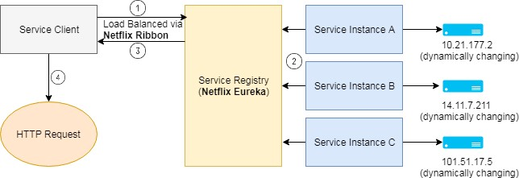
Client-side discovery
In client-side service discovery, client queries the Service Registry and determine the available service instances using a separate load balancing mechanism.
Load balancing usually works with Service Registry to load balance requests across the available service instances. Each HTTP request is done using one of the load balanced instance that is returned.
One of the major drawback in client-side discover is the tight coupling of client with Service Discovery and the Service discovery logic needs to be written at the client end.

Slide 30
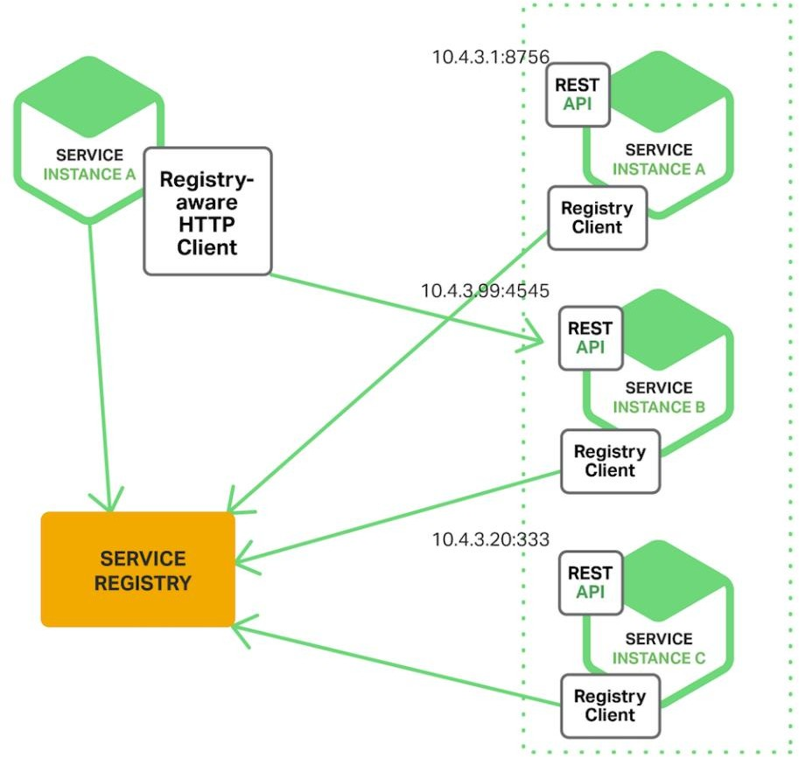
Client-side discovery

Slide 31
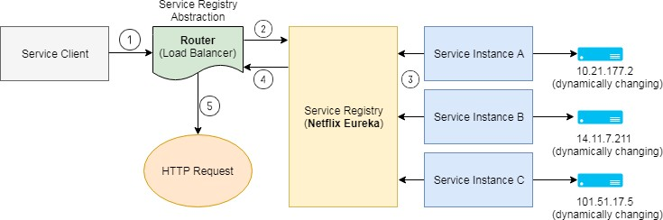
Server-side discovery
The client makes a request to a service via a load balancer. The load balancer queries the service registry and routes each request to an available service instance. As with client-side discovery, service instances are registered and deregistered with the service registry.
Details of Service Discovery are abstracted (or hidden) away from the client, as a result of which the client doesn’t need to write the discovery logic, which leads to loose coupling of client with the Service Discovery.
The AWS Elastic Load Balancer (ELB) is an example of a server-side discovery
router. An ELB is commonly used to load balance external traffic from the Internet.
HTTP servers and load balancers such as NGINX Plus and NGINX can also be
used as a server-side discovery load balancer.

Slide 32
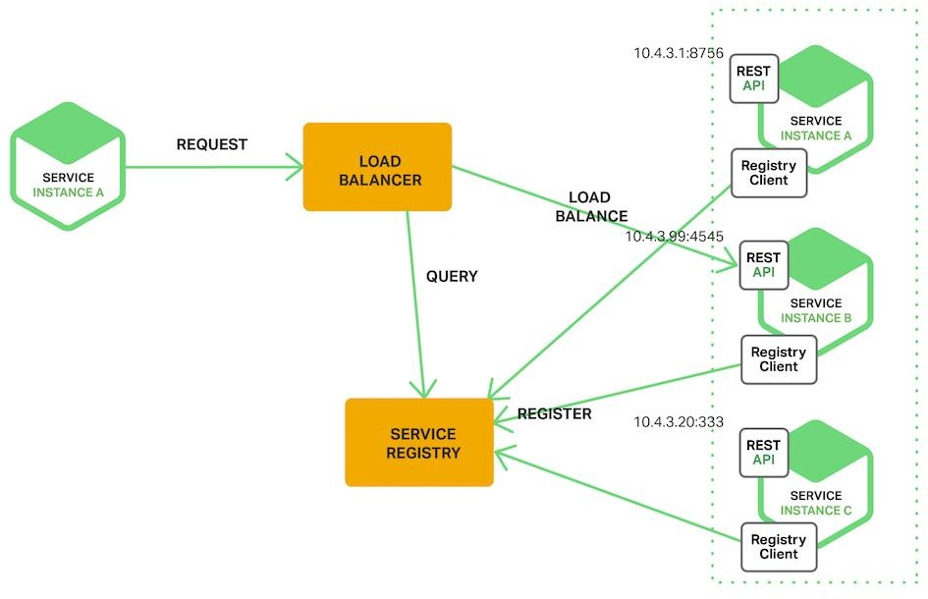
Server-side discovery

Slide 33
Netflix Eureka
Netflix Eureka is a service registry. It provides a REST API for managing
service-instance registration and for querying available instances.
Netflix Ribbon is an IPC client that works with Eureka to load balance requests across the available service instances.
Netflix Eureka provides a REST API to register (using a POST request) and query (using an HTTP GET request) service instances.
Netflix achieves the high availability by running one or more Eureka servers in each Amazon EC2 availability zone. Each Eureka in turn runs on an EC2 instance that has elastic IP address.
Note: An Elastic IP address is a static IPv4 address designed for dynamic cloud computing. An Elastic IP address is associated with your AWS account. With an Elastic IP address, you can mask the failure of an instance or software by rapidly remapping the address to another instance in your account.
Hashicorp’s Consul and Apache Zookeeper are other examples of Service Registry.

Slide 34
Netflix Ribbon
Netflix Ribbon is the Client side Load Balancer for Microservice architecture.
Netflix Ribbon is an IPC (Inter Process Communication) client that works with Eureka to load balance requests across the available service instances.
The @LoadBalanced annotation configures the RestTemplate to use Ribbon, which has been configured to use the Eureka client to query service discovery and fetch available service instances.

Slide 35
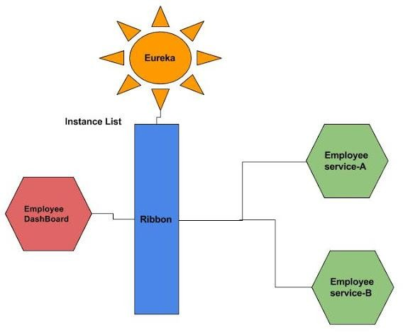
Netflix Ribbon
Client side load balancing

Slide 36
Netflix Ribbon
Step 1: To include Ribbon in EmployeeDashBoard we have to add the following
dependency in pom.xml
<dependency>
<groupId>org.springframework.cloud</groupId>
<artifactId>spring-cloud-starter-ribbon</artifactId>
</dependency>
Step 2: Now we have to enable Ribbon so it can Load balance the EmployeeSearch Application, for that we need to put @RibbonClient(name="EmployeeSearch") on top of the EmployeeServiceProxy interface.
By doing this we instruct Spring boot to communicate Eureka server and get the list of instances for service id EmployeeSearch. Please note that this is the {service-id} for the EmployeeSearch application.
@FeignClient(name="EmployeeSearch" )
@RibbonClient(name="EmployeeSearch")
Example
public interface EmployeeServiceProxy {
@RequestMapping("/employee/find/{id}")
public EmployeeInfo findById(@PathVariable(value="id") Long id);
@RequestMapping("/employee/findall") public Collection<EmployeeInfo> findAll();
}

Slide 37
Spring RestTemplate
RestTemplate is a Spring template (just like Spring JdbcTemplate) used to make HTTP Rest Calls (REST Client).
If you want to make a HTTP Call, you need to create a HttpClient, pass request and (or) form parameters, setup accept headers and perform unmarshalling of response, all by yourself, Spring Rest Templates, tries to take the pain away by abstracting all these details from you.
The RestTemplate class is the central class in Spring Framework for the synchronous calls by the client to access a REST web-service.
When using the RestTemplate class the user has to only provide the URL, the parameters(if any) and extract the results received. The RestTemplate manages the HTTP connections.

Slide 38
Spring RestTemplate
The RestTemplate is the central Spring class for client-side HTTP access.
Conceptually, it is very similar to the JdbcTemplate, JmsTemplate, and the various other templates found in the Spring Framework and other portfolio projects.
This means, for instance, that the RestTemplate is thread-safe once constructed, and that you can use callbacks to customize its operations.
RestTemplate Methods
The main entry points of the template are named after the six main HTTP methods:
HTTP | RESTTEMPLATE
DELETE | delete(String, String...)
GET | getForObject(String, Class, String...)
HEAD | headForHeaders(String, String...)
OPTIONS | optionsForAllow(String, String...)
POST | postForLocation(String, Object, String...)
PUT | put(String, Object, String...)

Slide 39
Spring RestTemplate
URI Templates
Each of these methods takes a URI as first argument. That URI can be a URI template, and variables can be used to expand the template to a normal URI.
The template variables can be passed in two forms: as a String variable
arguments array, or as a Map<String, String>.
The string varargs variant expands the given template variables in order, so that
String result = restTemplate.getForObject("http://example.com/hotels/{hotel}/bookings/{booking}", String.class, "42", "21");
The above will perform a GET on http://example.com/hotels/42/bookings/21.

Slide 40
Spring RestTemplate Example
Example
@GetMapping("/currency-converter/from/{from}/to/{to}/quantity/{quantity}") public CurrencyConversionBean convertCurrency(@PathVariable String from,
@PathVariable String to,
@PathVariable BigDecimal quantity) {
Map<String, String> uriVariables = new HashMap<>(); uriVariables.put("from", from); uriVariables.put("to", to);
ResponseEntity<CurrencyConversionBean> responseEntity = new RestTemplate().getForEntity(
"http://localhost:8100/currency-exchange/from/{from}/to/{to}", CurrencyConversionBean.class,uriVariables);
CurrencyConversionBean response = responseEntity.getBody(); return new CurrencyConversionBean(response.getId(), from, to,
response.getConversionMultiple(), quantity,
quantity.multiply(response.getConversionMultiple()),response.getPort());
}

Slide 41
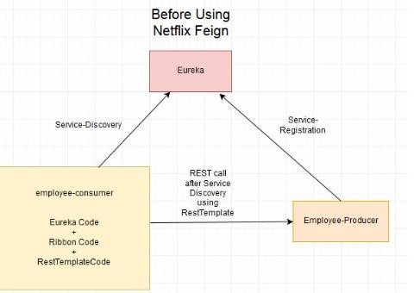
Spring Cloud- REST call using RESTTemplate
Spring Cloud- REST call using Spring RESTTemplate
For examples in the employee-consumer service, we consumed the REST services exposed by th
employee-producer using REST Template
But we had to write a lot of code to perform following-
For Load balancing using Ribbon.
Getting the Service instance and then the Base URL.
Make use of the REST Template for consuming service.

Slide 42
Netflix Feign
What is a Feign Client?
Feign is a declarative web service client, or declarative REST client. It makes
writing web service clients easier.
To use Feign create an interface and annotate it.
Spring Cloud integrates Ribbon and Eureka to provide a load balanced http
client when using Feign.
Netflix provides Feign as an abstraction over Rest-based calls, by which Microservice can communicate with each other, but developers don’t have to bother about Rest internal details.
Feign a client is an important tool for Microservice developer to communicate with other Microservices via Rest API.

Slide 43
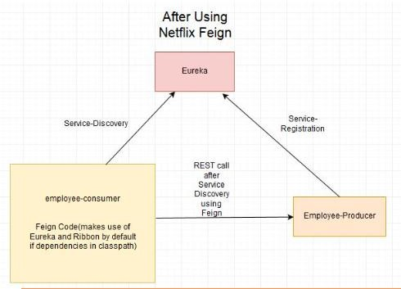
Spring Cloud- REST call using Netflix Feign Client

Slide 44
How to include Feign
To include Feign in your project use the starter with group
org.springframework.cloud and artifact id spring-cloud-starter-openfeign
@SpringBootApplication @EnableFeignClients
Example
public class Application {
public static void main(String[] args) {
SpringApplication.run(Application.class, args); }
}
@FeignClient("stores")
public interface StoreClient {
StoreClient.java
@RequestMapping(method = RequestMethod.GET, value = "/stores")
List<Store> getStores();
@RequestMapping(method = RequestMethod.POST, value = "/stores/{storeId}", consumes = "application/json")
Store update(@PathVariable("storeId") Long storeId, Store store);
}
In the @FeignClient annotation the String value ("stores" above) is an arbitrary client name, which is used to create a Ribbon load balancer.
The Ribbon client above will want to discover the physical addresses for the "stores" service. If your application is a Eureka client then it will resolve the service in the Eureka service registry.

Slide 45
Netflix Feign Example
@GetMapping("/currency-converter-feign/from/{from}/to/{to}/quantity/{quantity}") public CurrencyConversionBean convertCurrencyFeign(
@PathVariable String from, @PathVariable String to,
@PathVariable BigDecimal quantity) {
CurrencyConversionBean response = proxy.retrieveExchangeValue(from, to);
logger.info("{}", response);
return new CurrencyConversionBean(response.getId(), from, to, response.getConversionMultiple(), quantity,
quantity.multiply(response.getConversionMultiple()), response.getPort());
}

Slide 46
Microservices Implementation
Simple Microservices application using Spring Boot.
To create a Microservices system, we need to ensure of the below steps –
Creation of Eureka Discovery Server
With Spring Boot, just one annotation @EnableEurekaServer does the job.
Creating Producer Microservice
Register itself with Discovery Service
@EnableDiscoveryClient activates the Netflix
Eureka DiscoveryClient implementation
Create Consumer Microservice which finds the producer service instance registered with Discovery Service
Register itself with Discovery Service
@EnableDiscoveryClient activates the Netflix
Eureka DiscoveryClient implementation
Requests for DiscoveryClient instance of Producer Microservice using a smart RestTemplate. This step can be further simplified by using Netflix Feign instead of RestTemplate.
We can then test end-to-end result by starting the Eureka service first. Once
the Eureka service starts up, start the discovery clients one after the other.

Slide 47
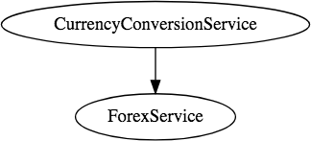
Microservices Implementation
Objective:
To create two microservices:
Forex Service - Abbreviated as FS
Currency Conversion Service - Abbreviated as CCS
Note: CCS will be using FS
Communication between CCS and FS

Slide 48
Microservices Implementation : Forex Service
Forex Service (FS) is the Service Provider. It provides currency exchange values for various currency.
Let’s assume that it talks to a Forex Exchange and provides the current conversion value between currencies.
An example request and response is shown below:
GET to http://localhost:8000/currency-exchange/from/EUR/to/INR
{
id: 10002,
from: "EUR",
to: "INR",
conversionMultiple: 75,
port: 8000,
}

Slide 49
Microservices Implementation : Currency Conversion Service
Currency Conversion Service (CCS) can convert a bucket of currencies into another currency. It uses the Forex Service to get current currency exchange values. CCS is the Service Consumer.
An example request and response is shown below:
GET to http://localhost:8100/currency-converter/from/EUR/to/INR/quantity/10000
{
id: 10002, fro
m: "EUR", to: "INR",
conversionMultiple: 75,
quantity: 10000,
totalCalculatedAmount: 750000,
port: 8000,
}

Slide 50
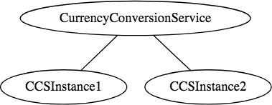
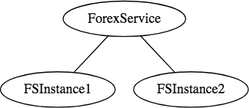
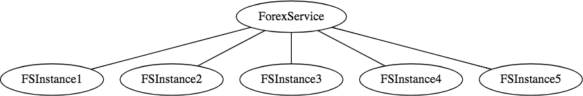
Microservices Implementation
We would want to be able to dynamically scale up and scale down the number of instances of each of these services.
And the number of instances for each service might vary with time. Below picture shows a specific instance where there are 5 instances of the Forex Service.

Slide 51
Microservices Implementation
Implementing a solution for dynamic scale up and down needs to answer two questions:
How does the Currency Conversion Service (CCS) know how many instances of Forex Service (FS) are active?
How does the Currency Conversion Service (CCS) distribute the load
between the active instances.
Because we want this to be dynamic, we cannot hardcode the URI’s of FS in CCS.
That is why we bring in a Naming Server.
All instances of the components (CCS and FS) register with the Eureka Naming Server.
When FS needs to call the CCS, it will ask Eureka Naming Server for the
active instances.
We will use Ribbon to do client-side load balancing between the different instances of FS.

Slide 52
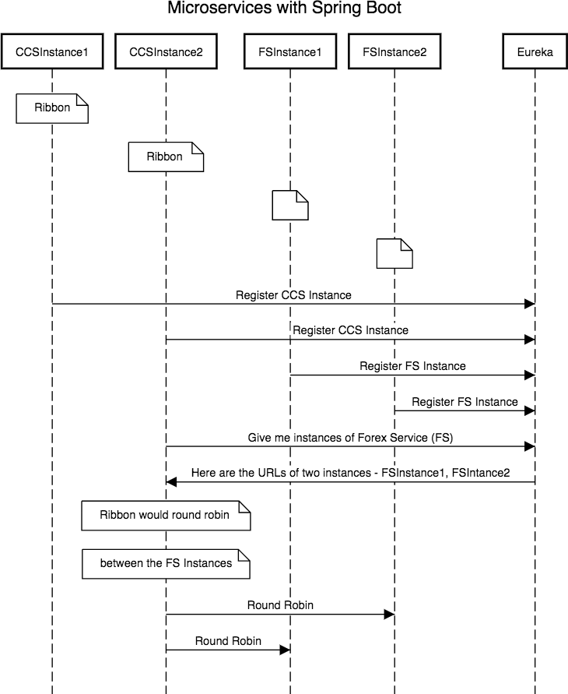
A high level sequence diagram

Slide 53
Microservice Application
Steps
Creating a Forex Microservice - We will create a simple rest service based on Spring Boot Starter Web and Spring Boot Started JPA. We will use Hibernate as JPA implementation and connect to H2 database.
Create the CCS - Currency Conversion Service - We will create a simple
rest service using feign to invoke the Forex Microservice
Use Ribbon for Load Balancing(Client-side discovery)
Implement Eureka Naming Service and connect FS and CCS through Eureka.

Slide 54
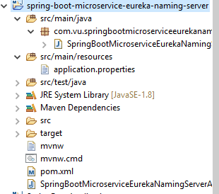
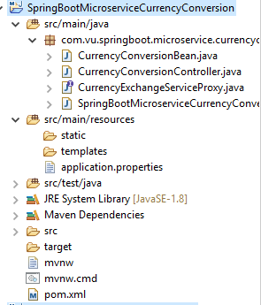
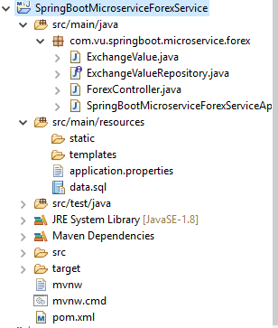
Microservice Application

Slide 55

Thank You!

